Slide 1
1. Business Environment

Slide 2
Concept of Business Environment
A business environment is all the components that affect a business. These include both internal factors, like employees and resources, and external factors, like customers and markets.
Business Environment is sum or collection of all internal and external factors such as employees, customers needs and expectations, supply and demand, management, clients, suppliers, owners, activities by government, innovation in technology, social trends, market trends, economic changes, etc.
These factors affect the function of the company and how a company works directly or indirectly. Sum of these factors influences the companies or business organizations environment and situation.

Slide 3
Other definitions of Business Environment
The word ‘Business Environment’ has been defined by various authors is as follows:
“Business Environment encompasses the -climate’ or set of conditions, economic, social, political or institutional in which business operations are Conducted.”— Arthur M. Weimer
“Environment contains the external factors that create opportunities and threats to the business. This includes socio-economic conditions, technology and political conditions.” – William Gluck and Jauch
‘‘Business environment is the aggregate of all conditions, events and influences that surround and affect it.”— Keith Davis

Slide 4
Significance/Importance of Business Environment:
Help to understand Internal Environment: It is very much important for business enterprise to understand its internal environment, such as business policy, organization structure etc. In such case an effective management information system will help to predict the business environmental changes.
Help to Understand Market Conditions: It is necessary for an enterprise to have the knowledge of market structure and changes taking place in it. The knowledge about increase and decrease in demand, supply, monopolistic practices, government participation in business etc., is necessary for an enterprise.
Determining Opportunities and Threats: The interaction between the business and its environment would identify opportunities and threats to the business. It helps the business enterprises for meeting the challenges successfully.

Slide 5
Significance/Importance of Business Environment:
Giving direction for growth: The interaction with the environment leads to opening up new frontiers of growth for the business firms. It enables the business to identify the areas for growth and expansion of their activities.
Continuous learning: Environmental analysis makes the task of managers easier in dealing with business challenges. The managers are motivated to continuously update their knowledge, understanding and skills to meet the predicted changes in realm of business.
Image building: Environmental understanding helps the business organization in improving their image by showing their sensitivity to the environment with which they are working.
Meeting competition: It helps the firms to analyze the competitors’ strategies and formulate their own strategies accordingly.

Slide 6
Components of Business Environment
Components
Employees
External
Internal
Shareholders
Organizational Culture
Labor Union
Organizational Structure
Task Environment
General Environment

Slide 7
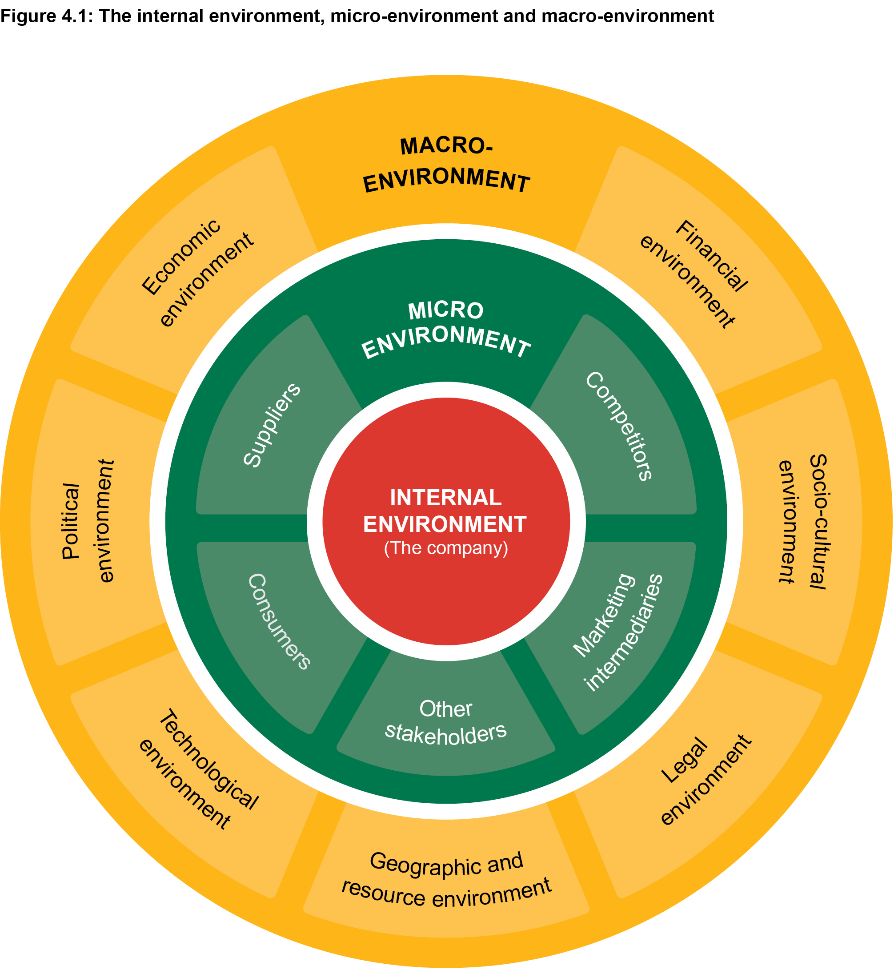
Employees
Shareholders
Organizational Culture
Labor Union
Organizational Structure

Slide 8
Internal Environment

Slide 9
Internal Environment
Employees: They are the main components and important assets of organizations. They are responsible to work as per the direction, goals, rules and regulation of the company .For their better performance, organizations have to motivate and satisfied them with fair and equitable rewards policies. The organizations’ productivity can be enhanced only by the dedication, loyalty, and cooperation of employees.
Shareholder and Board of Directors: Shareholders being the owners of business, have a direct interest in the performance of the organization. The board of directors is elected by them (shareholders) who represents shareholders’ interest in the board. The board is responsible to manage company and formulate appropriate plans. They evaluate overall organizational performance and provide direction to the top level management for the growth of an organization.
Organizational culture: Every organization has its own culture. Culture refers to set of values, beliefs, norms of an organization under which it operates. It helps to bind all the employees and comply with organizational rules and regulations. Culture has a powerful influence on the process of organizational change and decision making.

Slide 10
Internal Environment
Labor Union: Labor union represents the employees or labor working in an organization. It takes problems and feeling of the labors to the management for constructive solutions. The good relation between labor union and management avoids unnecessary disturbances in organizations.
Organizational Structure: Structure is a framework of an organization. It clarifies the authority and responsibility roles and relations, hierarchy of management and coordination activities for business.

Slide 11
External Environment
Task/Micro/Operation Environment
General Environment

Slide 12
Task Environment
Customers: Customers exchange resources, usually in the form of money for an organization’s product and services. A customer maybe an individual, family, a business house or an institution. Customer not only buys the product or services they also give valuable ideas, opinions and reaction related to it. Thus, manager should maintain close relationship with them.
Suppliers: Suppliers are the organizations which provide resources like materials, men, machines etc. to other firms. As the quality and price of the raw material received from the suppliers determine the quality of the output, the business firm tries to obtain lower prices, better quality and fast deliveries. This strengthens the competitive position of organizations.
Government: The role of the government is to regulate business system and to protect the interest of customers and general public. It formulates rules and regulation, business policies etc. under which every firms need to operate. Therefore, government has great influence on corporate policies, procedures and business practices of modern organizations.

Slide 13
Task Environment
Competitors: It refers to organizations that compete for resources with other organizations and provides the similar or substitute product and services to the same group of people. The organization must analyze the competition and established clearly defined marketing strategies in order to provide superior customer satisfaction and to increase market share.
Media: The media keeps eye on the vital decision or actions of the business firms having general public interest. Therefore managers need to have good communication with both media and external audiences and deal with them effectively and promptly.
Financial institutions: Organizations depends on a variety of financial institutions such as: banks, insurance companies, capital markets, etc to supply fund for maintaining and expanding their business activities. The terms and conditions of loans and advances and quality of promptness of their services have an impact on the performance of business firms.
Special Interest Group: It refers to environmentalist, unions, consumer advocates, civic society and other professional organization. These organizations pressurized the company to advance their position on the issues like quality services, reasonable price, waste management, environmental protection etc

Slide 14
General Environment
Economic Environment: Economic conditions are critical to the success of the organizations. It is defined as the nature and direction of the economic system of a country and their impact on the individual organization. The economic factors such as: national income, saving ,investment, monetary policies, economic growth, interest rate, consumption pattern etc., have great impact on functioning of an organization. Therefore, managers should devote much of their time and resources to forecast the economy and possible changes.
Socio-Cultural Environment: The socio-cultural environment affects the behavior of people and their organizations. It includes values, belief, lifestyle, family system, opinions and assumptions widely held by the citizen of the particular country. These elements of society impact the business organizations.

Slide 15
General Environment
Technological Environment: Technology is the practical application of scientific knowledge. Radical development has occurred over the past several years in communication, information and automation including robotics. This development brings both opportunity and threats for the organizations. Thus, organizations should utilize their strength to gain from opportunity and neutralize the threats.
Political Environment: It refers to the influence from government institutions, strategies of political parties, policies of state and local government and relationship between government and business. Managers must know about political environment because:
It imposes certain legal constraint on the business.
It establishes a market atmosphere that maybe pro-business or anti- business.
It has the potential to provide stability needed for long-term planning.

Slide 16
SWOT Analysis Concept and Components
Albert Humphrey of the Stanford Research Institute created this method in the 1960s during a study conducted to identify why corporate planning consistently failed. Since its creation, the SWOT analysis has become one of the most useful tools for business owners to start and grow their companies.
SWOT (strengths, weaknesses, opportunities, and threats) analysis is a framework used to evaluate a company's competitive position and to develop strategic planning.
SWOT analysis assesses internal and external factors, as well as current and future potential.
A SWOT analysis pulls information internal sources (strengths of weaknesses of the specific company) as well as external forces that may have uncontrollable impacts to decisions (opportunities and threats).
The primary goal of SWOT analysis is to increase awareness of the factors that go into making a business decision or establishing a business strategy.

Slide 17
Components of SWOT Analysis
Strength : Strengths are the unique advantages and internal capabilities that give the company a competitive edge in the market. A strong brand reputation, innovative products or services, or exceptional customer service are just a few examples. By identifying and capitalizing on strength of the company, the organization can foster customer loyalty and build a solid foundation for growth.
Weakness: No business is flawless. Weaknesses are areas where the company may face challenges or fall short of potential. It could be outdated processes, skill gaps within the team, or inadequate resources. By acknowledging these weaknesses, an organization can establish targeted initiatives for improvement, up skill your team, adopt new technologies, and enhance your overall operational efficiency.

Slide 18
Components of SWOT Analysis
Opportunities: Opportunities are external factors that can contribute to company's progress. These may include emerging markets, technological advancements, changes in consumer behavior, or gaps in the market that the company can fill. By seizing these opportunities, organization can expand market reach, diversify product offerings, forge strategic partnerships, or even venture into untapped territories.
Threats: Threats are external factors that are beyond the control of the organization and pose challenges to the business. Increased competition, economic instability, or even changing market trends are examples of threats. By proactively assessing and addressing them, you can develop contingency plans, adjust your strategies, and minimize their impact on your operations.

Slide 19
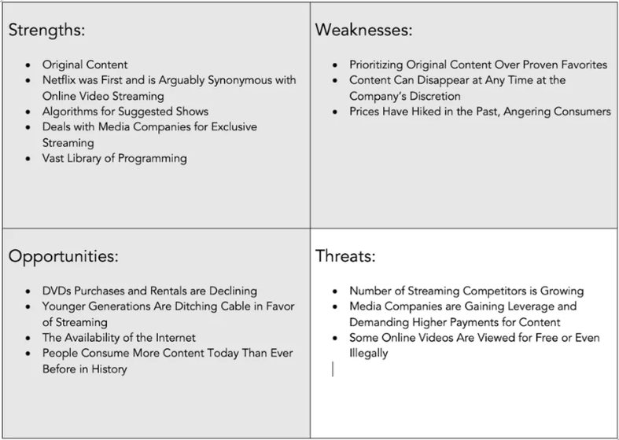
SWOT Analysis (Netflix)

Slide 20

Environmental Scanning
Every organization has an internal and external environment. In order for the organization to be successful, it is important that it scans its environment regularly to assess its developments and understand factors that can contribute to its success.
Environmental scanning is a process used by organizations to monitor their external and internal environments.
The purpose of the scan is the identification of opportunities and threats affecting the business for making strategic business decisions.
As a part of the environmental scanning process, the organization collects information regarding its environment and analyzes it to forecast the impact of changes in the environment. This eventually helps the management team to make informed decisions.

Slide 21
Process of Environmental Scanning
Study the forces and nature of the environment
Determine the source of information
(secondary sources like Mass media, formal studies)
Scan and access the trend
(Opportunities and threats)
Determine the techniques of environmental scanning (Delphi, historical analogy)

Slide 22
Methods of Environmental Scanning
Executive opinion method
Expert opinion method
Historical Analogy
Intuitive reasoning
Scenario Building
Delphi method
Extrapolating method

Slide 23
Emerging Business Environment in Nepal
Increased private investment
Growing urban population
Increase in educated customers
Changing role of government
Rising economic agenda
Workforce diversity
Use of modern technologies
Shifting socio-cultural values

